Slide 1
Covalent Bonding

Slide 2
What is a covalent bond?
A covalent bond forms between two atoms that are sharing one or more pair of electrons.

Slide 3
Covalent Bond
Usually occurs when the electronegativity difference between the two elements is small (<1.7)

Slide 4
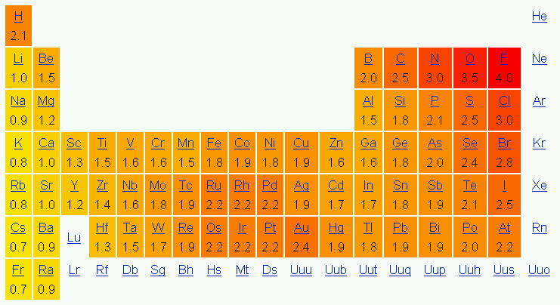

Slide 5
Covalent Bond
Covalent bonds form between two nonmetals.

Slide 6
Covalent Bond
The bond results from an overlapping of orbitals.

Slide 7
Covalent Bond
A covalent bond is a weaker bond than an ionic bond.

Slide 8
Properties of Covalent Compounds
low melting point
gases or liquids at room temp (some are soft solids)
do not conduct electricity
many are insoluble in water.

Slide 9
Naming covalently bonded compounds.
The first element is named according to the element name.
An –ide ending is added to the name of the second element.
Numerical prefixes are used to indicate the number of each type of atom present.

Slide 10
Numerical Prefixes
Prefix | Number
*Mono (only used with the second element) | 1
Di | 2
Tri | 3
Tetra | 4
Pent | 5
Hex | 6
Hept | 7
Oct | 8
Non | 9
Dec | 10

Slide 11
Name the following compounds
CO2
CO
N2O
NO
NO2
N2O3
N2O4
N2O5
PCl5
PCl3
SF6

Slide 12
Write the formulas for the following compounds:
Sulfur trioxide
Dioxygen difluoride
Tetraphosphorus decaoxide
Diboron trioxide
Arsenic pentafluoride
Silicon dioxide
Dihydrogen monoxide
Nitrogen trihydride

Slide 13
Types of Covalent Bonds
A single covalent bond occurs when one pair of electrons (2 electrons) are shared between two atoms.
A double covalent bond occurs when two atoms share two pairs (4 electrons) of electrons.
A triple covalent bond occurs when two atoms share three pairs (6 electrons) of electrons.
A triple bond is the strongest type of bond.

Slide 14
Polar vs. Nonpolar Bonds
If the electrons are shared equally, it is called a nonpolar covalent bond. (This type of bond only occurs if the electrons are shared between identical atoms)
Molecules consisting of nonpolar bonds are also nonpolar.
Examples of nonpolar molecules include all of the diatomic molecules (H₂, N₂, O₂, Cl₂, Br₂, I₂, F₂)

Slide 15
Polar vs. Nonpolar Bonds
If the electrons are shared unequally, it is called a polar covalent bond.
Just because a molecule possesses polar bonds does not mean the molecule as a whole will be polar.
If the dipoles cancel (the dipoles are arranged symmetrically), the molecule is nonpolar.
If the dipoles do not cancel (the dipoles are arranged asymmetrically), the molecule is polar.

Slide 16
Summary of Polar and Nonpolar Molecules
Molecules are nonpolar if:
1) the bonds are nonpolar
2) the polar bonds are arranged symmetrically
Molecules are polar if the polar bonds are arranged asymmetrically.

Slide 17
“Like dissolves Like”
Nonpolar molecules will dissolve in other nonpolar substances due to their similar structure.
Polar molecules will dissolve in other polar molecules due to the force of attraction between the positive end of one polar molecule and negative end of another polar molecule.
Ionic compounds will also dissolve in polar compounds.
Corn oil does not dissolve in water. Is corn oil polar or nonpolar?

Slide 18
Lewis Dot Diagrams
Cl2
Linear
Nonpolar bonds
Nonpolar molecule
Chlorine

Slide 19
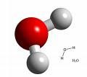
Lewis Dot Diagrams
H2O
Bent
Polar bonds
Polar molecule
Dihydrogen monoxide

Slide 20
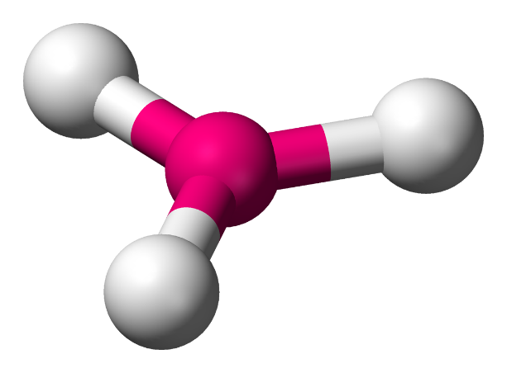
Lewis Dot Diagrams
BF3
Trigonal planar
Polar bonds
Nonpolar molecule
Boron trifluoride

Slide 21
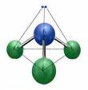
Lewis Dot Diagrams
NH3
Trigonal pyramidal
Polar bonds
Polar molecule
Nitrogen trihydride

Slide 22
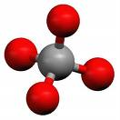
Lewis Dot Diagrams
CH4
Tetrahedral
Polar bonds
Nonpolar molecule
Carbon tetrahydride

Slide 23
In covalent compounds, atoms become stable by ___ their valence electrons.
transferring
sharing
0
1 | 2 | 3 | 4 | 5 | 6 | 7 | 8 | 9 | 10 | 11 | 12 | 13 | 14 | 15 | 16 | 17 | 18 | 19 | 20
21 | 22 | 23

Slide 24
A ___ covalent bond is the result of an equal share of electrons by both atoms.
polar
nonpolar
0
1 | 2 | 3 | 4 | 5 | 6 | 7 | 8 | 9 | 10 | 11 | 12 | 13 | 14 | 15 | 16 | 17 | 18 | 19 | 20
21 | 22 | 23

Slide 25
A cation has a ___ charge.
positive
negative
0
1 | 2 | 3 | 4 | 5 | 6 | 7 | 8 | 9 | 10 | 11 | 12 | 13 | 14 | 15 | 16 | 17 | 18 | 19 | 20
21 | 22 | 23

Slide 26
When an atom ___ electrons, it becomes positively charged.
gains
loses
0
1 | 2 | 3 | 4 | 5 | 6 | 7 | 8 | 9 | 10 | 11 | 12 | 13 | 14 | 15 | 16 | 17 | 18 | 19 | 20
21 | 22 | 23

Slide 27
In the formula CO₂, the number 2 is called a ___.
superscript
oxidation number
charge
subscript
0
1 | 2 | 3 | 4 | 5 | 6 | 7 | 8 | 9 | 10 | 11 | 12 | 13 | 14 | 15 | 16 | 17 | 18 | 19 | 20
21 | 22 | 23

Slide 28
What is the correct name for PCl₃?
Monophosphorus trichloride
Phosphorus chloride
Phosphorus trichloride
Traphosphorus chloride
0
1 | 2 | 3 | 4 | 5 | 6 | 7 | 8 | 9 | 10 | 11 | 12 | 13 | 14 | 15 | 16 | 17 | 18 | 19 | 20
21 | 22 | 23

Slide 29
What is the correct name for Li₂O?
Lithium oxide
Dilithium oxide
Lithium (II) oxide
Lithium dioxide
0
1 | 2 | 3 | 4 | 5 | 6 | 7 | 8 | 9 | 10 | 11 | 12 | 13 | 14 | 15 | 16 | 17 | 18 | 19 | 20
21 | 22 | 23

Slide 30
Which is not a diatomic molecule?
Fluorine
Nitrogen
Bromine
Boron
0
1 | 2 | 3 | 4 | 5 | 6 | 7 | 8 | 9 | 10 | 11 | 12 | 13 | 14 | 15 | 16 | 17 | 18 | 19 | 20
21 | 22 | 23

Slide 31
Which element is a nonmetal?
Boron
Lithium
Carbon
Magnesium
0
1 | 2 | 3 | 4 | 5 | 6 | 7 | 8 | 9 | 10 | 11 | 12 | 13 | 14 | 15 | 16 | 17 | 18 | 19 | 20
21 | 22 | 23

Slide 32
Which element has 7 valence electrons?
Boron
Nitrogen
Fluorine
Manganese
0
1 | 2 | 3 | 4 | 5 | 6 | 7 | 8 | 9 | 10 | 11 | 12 | 13 | 14 | 15 | 16 | 17 | 18 | 19 | 20
21 | 22 | 23

Slide 33
Noble gases are stable because they have __ valence electrons.
2
4
6
8
0
1 | 2 | 3 | 4 | 5 | 6 | 7 | 8 | 9 | 10 | 11 | 12 | 13 | 14 | 15 | 16 | 17 | 18 | 19 | 20
21 | 22 | 23

Slide 34
The noble gases are in which block of the periodic table?
s
p
d
f
0
1 | 2 | 3 | 4 | 5 | 6 | 7 | 8 | 9 | 10 | 11 | 12 | 13 | 14 | 15 | 16 | 17 | 18 | 19 | 20
21 | 22 | 23

Slide 35
Electrons have what charge?
-1
+1
0
0
1 | 2 | 3 | 4 | 5 | 6 | 7 | 8 | 9 | 10 | 11 | 12 | 13 | 14 | 15 | 16 | 17 | 18 | 19 | 20
21 | 22 | 23

Slide 36
How many valence electrons are in an atom of oxygen?
2
4
6
8
0
1 | 2 | 3 | 4 | 5 | 6 | 7 | 8 | 9 | 10 | 11 | 12 | 13 | 14 | 15 | 16 | 17 | 18 | 19 | 20
21 | 22 | 23

