Slide 1
States of Matter
Solids, liquids, Gases

Slide 2
Review of Ionic vs Covalent Bonds
Ionic:
Metal and nonmetal
Transfer of electrons
Stronger bond
Covalent:
Nonmetal and nonmetal
Sharing of electrons (equal or unequal)
Weaker bond

Slide 3
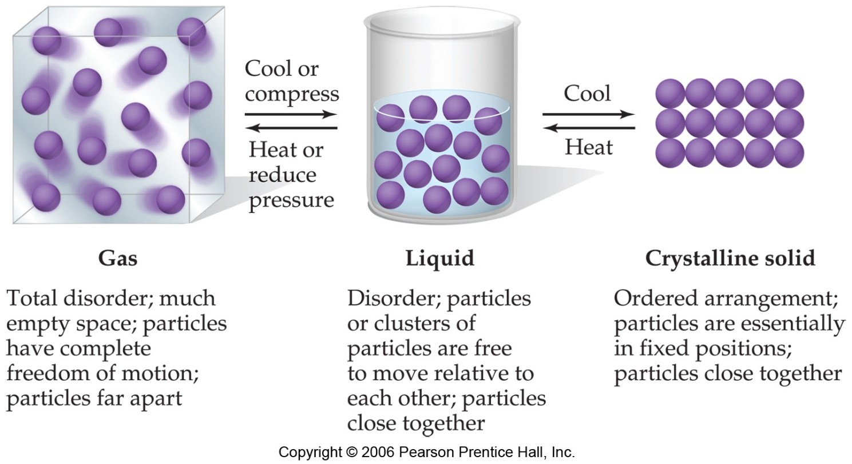
States of Matter
Forces other than chemical bonds determine if a substance is a solid, liquid or gas at room temperature

Slide 4
Intermolecular forces
Intermolecular forces are how one molecule interacts with the molecule next to it.
It is not an interaction between atoms, that is a BOND (ionic or covalent).
Intermolecular forces are weaker than bonds between atoms

Slide 5
Types of intermolecular forces
Dispersion forces- weak attractions due to shifts in the electrons that are in the electron cloud.
These are TEMPORARY forces
Example: Dry ice
Carbon dioxide is a gas at room temperature yet when the temperature is cold enough the particles will have enough attraction for each other to come close together and form a solid.

Slide 6
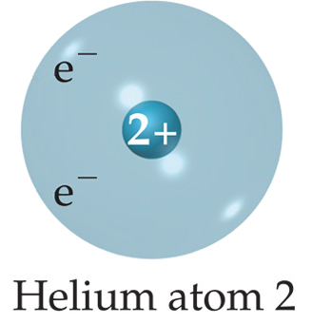
The electrons in the outer level of helium
repel each other (so tend to stay far away from
each other), occasionally wind up on the same
side of the atom.
At that instant, the helium atom is polar, with
an excess of electrons on one side and a shortage
on the other side.

Slide 7
Another Helium nearby would be attracted to
the “polar” Helium. Remember – it is only a
temporary arrangement – the electrons are still
moving!
These forces are weak forces
Exist mainly between noble gas atoms and
nonpolar molecules

Slide 8
The strength of dispersion forces
increases with increased molecular
weight.
(bigger atom/molecule = stronger force)

Slide 9
Which has the stronger Dispersion force?
Cl₂
Br₂
Which has the stronger Dispersion force?
He
Ne
Ar
Xe

Slide 10
Which has the stronger Dispersion force?
CH₄
C₂H₆
C₄H₁₀

Slide 11
Types of Intermolecular Forces
Dipole-Dipole Forces form between 2 polar molecules.
Remember polar molecules have an area that is permanently positive and permanently negative due to electronegativity in the bond that holds the atoms together
Example HCl

Slide 12
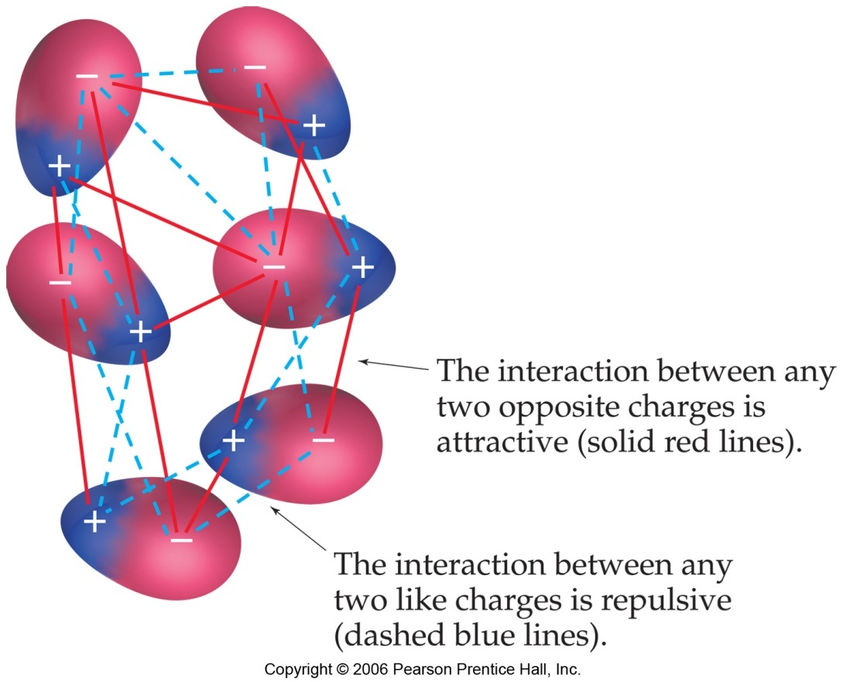
Dipole – Dipole forces
The positive end of one is attracted to the negative end of the other and vice-versa.

Slide 13
Which of the following molecules have dipole-dipole forces present?
NH₃
CH₄
Both

Slide 14
Types of Intermolecular Forces
Hydrogen bonds - form when both molecules contain hydrogen and either N, O, or F.
Are unusually strong forces
Example: (H₂O)
Water is polar. The interaction occurs when the negatively charged oxygen on one water molecule is attracted to the positively charged Hydrogen on a different water molecule.

Slide 15
Hydrogen Bonding

Slide 16
Which of the following compounds has hydrogen bonding present?
H₂S
H₂O
Both

Slide 17
Properties of Liquids

Slide 18
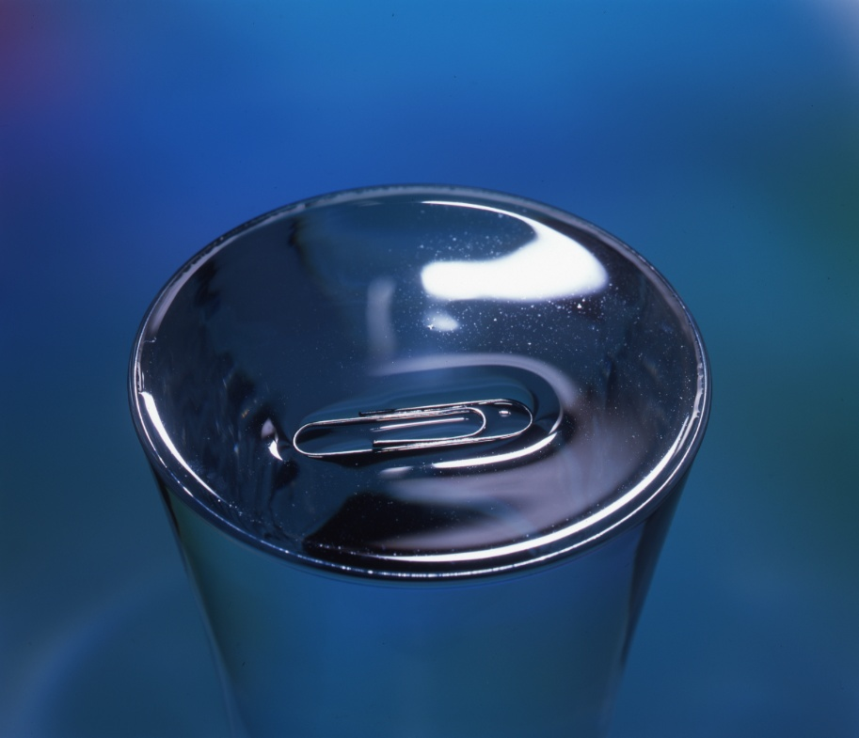
Surface Tension
Resistance of a liquid to increase in surface area
Measure of the inward forces
Liquids with high intermolecular forces have high surface tensions

Slide 19
Capillary Action
Spontaneous rising of a liquid in a narrow tube
Caused by cohesive and adhesive forces
cohesive forces-intermolecular forces among liquid molecules
adhesive forces- force between the liquid molecules and the container; occur when the container is made of a polar substance

Slide 20
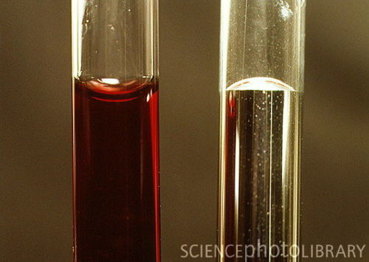
Example of Capillary Action
When water is placed in a glass graduated cylinder, the meniscus is concave
adhesive forces > cohesive forces (glass is polar)
When mercury is placed in the same graduated cylinder, the meniscus is convex
cohesive forces > adhesive forces (mercury contains only dispersion forces-nonpolar)

Slide 21
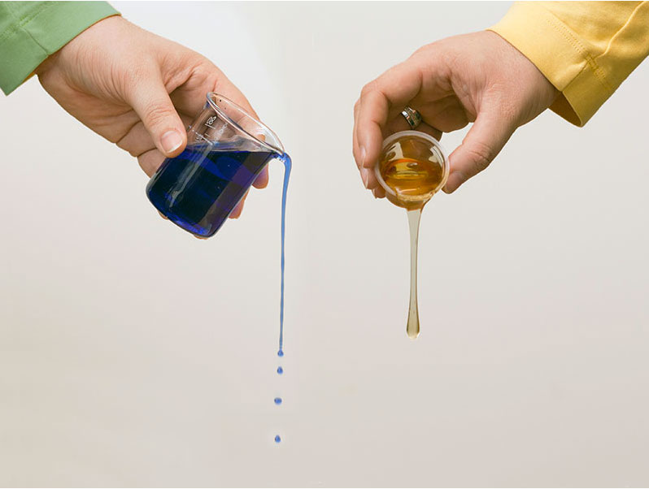
Viscosity
A resistance to flow
Strong intermolecular forces result in high viscosity
Large molecules also have high viscosity due to greater London Dispersion forces
As temperature increases, viscosity decreases (Example: Warm Maple Syrup)

Slide 22
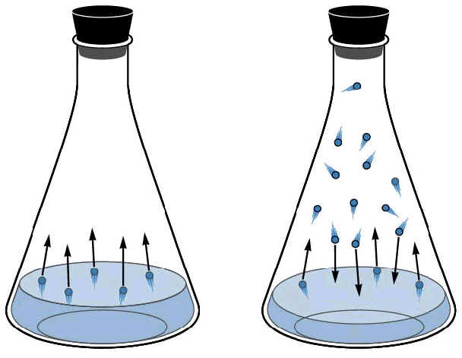
Vapor Pressure
Pressure of vapor above the surface of a liquid
Caused when the molecules on the surface break away and go into the gas phase
In order to break away, the molecules must possess a minimum amount of kinetic energy
High intermolecular forces result in low vapor pressures
Volatile liquids are liquids that evaporate rapidly resulting in high vapor pressures

Slide 23
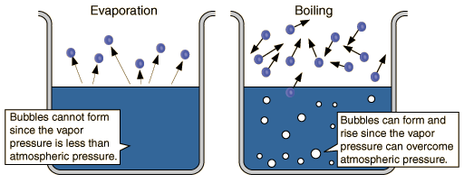
Vapor Pressure (continued)
Substances with weak intermolecular forces tend to be volatile
As temperature increases, vapor pressure increases (more molecules possess the minimum kinetic energy and the rate of evaporation increases)
See the diagram on page 460.

Slide 24
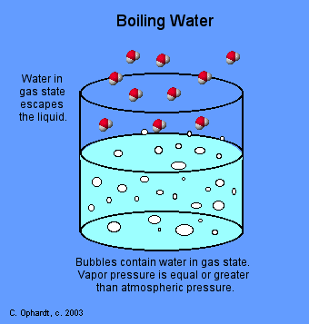
Melting Point and Boiling Points
Melting point- temperature at which the solid and liquid have the same vapor pressure
Boiling point-temperature at which the vapor pressure is equal to 1 atm (atmospheric pressure)
Melting and boiling points are higher when the intermolecular forces are stronger

