Slide 1
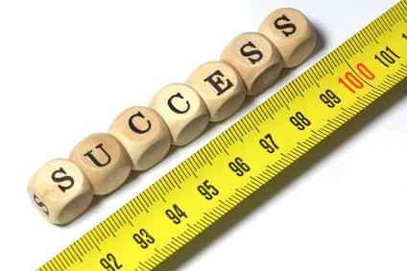
International System (SI) of Measurement

Slide 2
International System of Measurement
The International System of Measurement is a revised version of the Metric System.
The measuring system consists of seven base units.

Slide 3
International System of Measurement
From these base units, all other SI units of measurement are derived.
Derived units consist of one or more base units used in combination and are used for measurements such as volume and density.

Slide 4
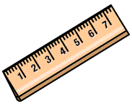
International System of Measurement
Quantity: Length
Definition: Distance between two points
SI Unit: Meter (m)
Lab Unit: Centimeter, Kilometer, Millimeter….
Base/Derived: Base Unit
Lab Equipment: Meter Stick/Ruler

Slide 5
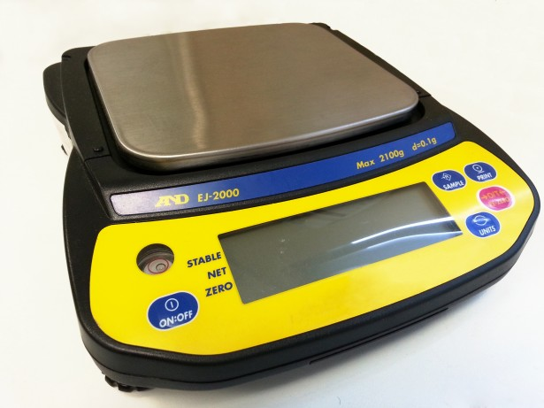
International System of Measurement
Quantity: Mass
Definition: Amount of Matter
SI Unit: Kilogram (Kg)
Lab Unit: Gram (g)
Base/Derived: Base Unit
Lab Equipment: Balance

Slide 6
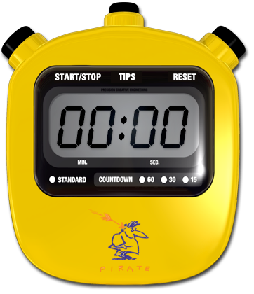
International System of Measurement
Quantity: Time
Definition: Interval between two occurrences
SI Unit: Second (s)
Lab Unit: Second (s)
Base/Derived: Base Unit
Lab Equipment: Stopwatch

Slide 7
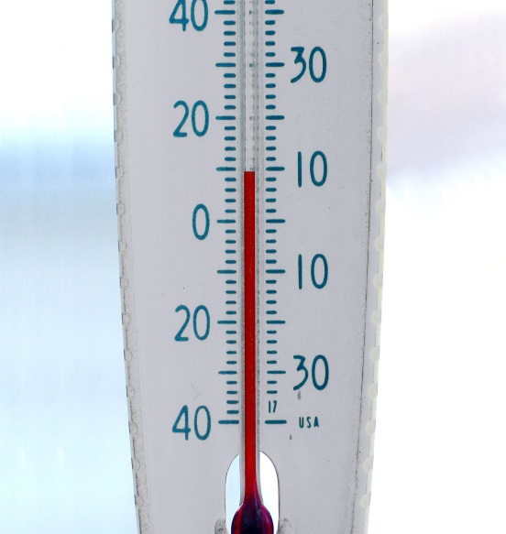
International System of Measurement
Quantity: Temperature
Definition: Average Kinetic Energy of the Particles
SI Unit: Kelvin (K)
Lab Unit: Degree Celsius (ºC)
Base/Derived: Base Unit
Lab Equipment: Thermometer

Slide 8
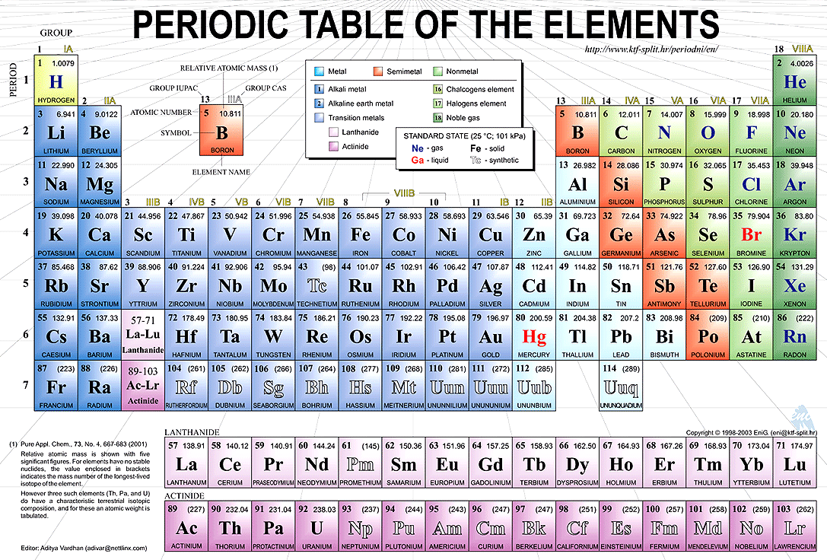
International System of Measurement
Quantity: Amount of Substance
Definition: Number of particles in a sample
SI Unit: mole (mol)
Lab Unit: mole (mol)
Base/Derived: Base Unit
Lab Equipment: Periodic Table

Slide 9
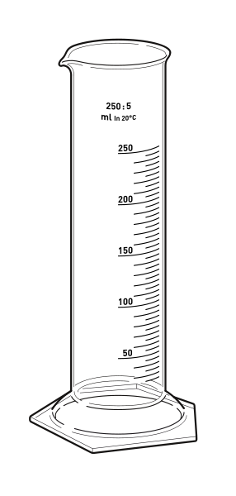
International System of Measurement
Quantity: Volume
Definition: Amount of space
SI Unit: Cubic meter (m³)
Lab Unit: Liter (L) or milliliter (mL)
Base/Derived: Derived Unit
Lab Equipment: Graduated Cylinder or Ruler

Slide 10
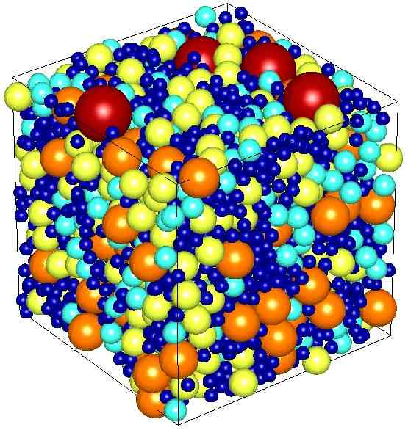
International System of Measurement
Quantity: Density
Definition: Amount of matter in a given space
SI Unit: g/cm³
Lab Unit: g/ml
Base/Derived: Derived Unit
Lab Equipment: Balance & Graduated Cylinder

Slide 11
Measuring Volume
Meniscus – the curve that forms at the surface of a liquid
measure the center of the curve for accuracy
Volume of a symmetrical solid-measure dimensions with a meter stick; use correct mathematical formula
Volume of an irregular solid → water displacement
measure an amount of water in a graduated cylinder; place object to be measured in cylinder; read the new level of water; subtract the starting level from the final level.
1 cm³ = 1 ml

